Slide 1
Scotland
Richard Hudec 7.B

Slide 2
The largest cities of Scotland
Edinburg→ 495 360 people
Glasgow→ 598 830 people

Slide 3
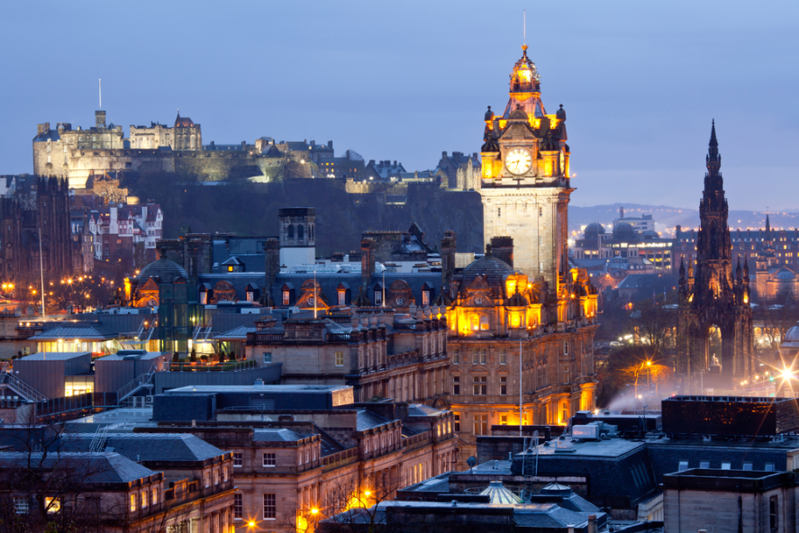
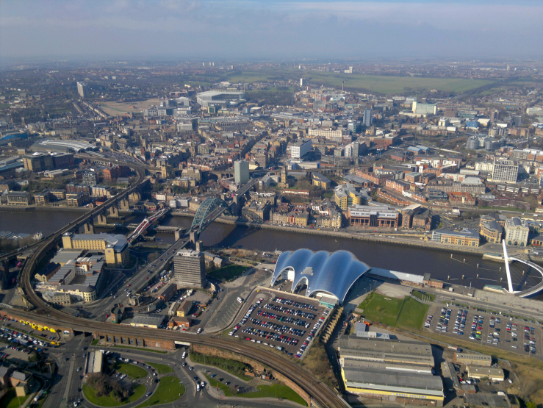
Pictures
Edinburg Glasgow

Slide 4
Places of Interest
Places of interest of Scotland are:
Loch Ness
Ben Nevis
Forth Railway Bridge

Slide 5
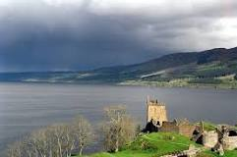
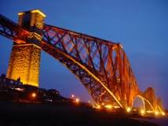
Pictures
Loch Ness Ben Nevis Forth Railway Bridge

Slide 6
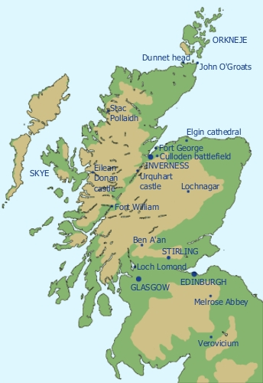
Expanse and Population
Expanse of Scotland is 78,387 sq km.
In Scotland live 5,295 milion people.

Slide 7
Location of Scotland
Scotland is a country that is part of the United Kingdom.
Occupying the northern third of the island of Great Britain.

Slide 8
The official languages of Scotland
The official languages of Scotland are English, Scottish Gaelic and Scottish.

Slide 9
Transport in Scotland
In Scotland are five main international airports:
Glasgow
Edinburg
Aberdeen
Prestwick
Inverness

Slide 10
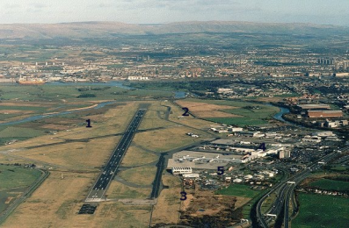
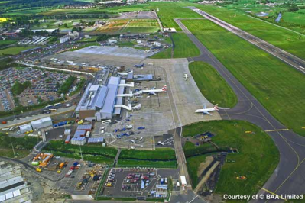
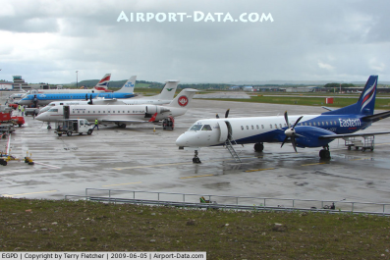
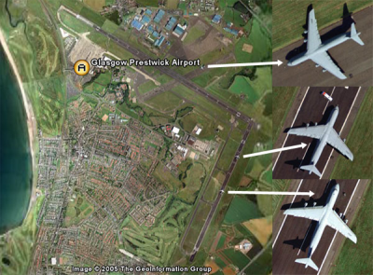
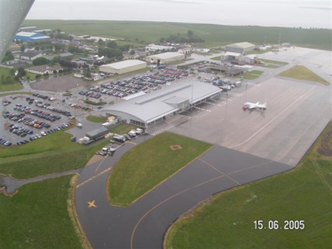
Pictures
Glasgow Edinburg Aberdeen
Prestwick Inverness

Slide 11
Thank you for attention
January/2014

